Slide 1

Snake Species identification using Machine Learning
Emerson Cardoso
Sameer Hans
Mohd Aamir
2022

Slide 2
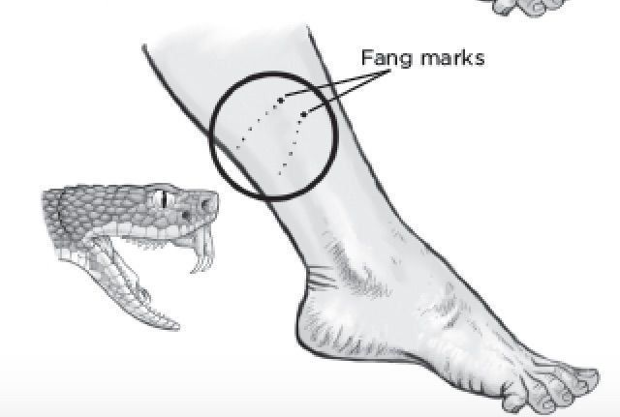

STATEMENT
Necrosis
Renal or hepatic insufficiency
Amputation of limbs
Death, etc.
may cause
can be reversed or prevented
The antidote must be applied:
As quickly
And accurately

Slide 3

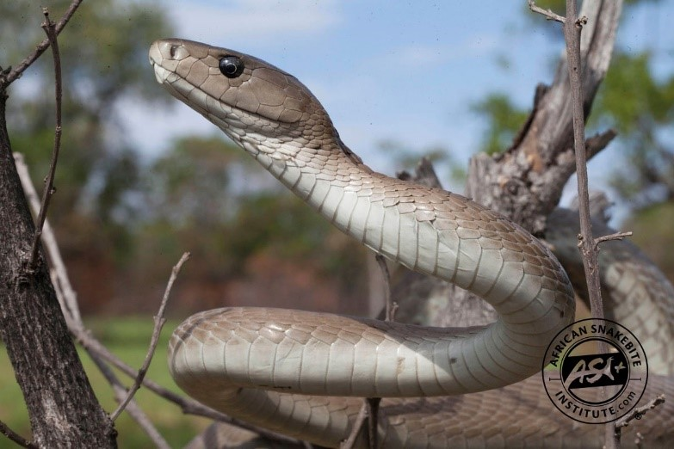
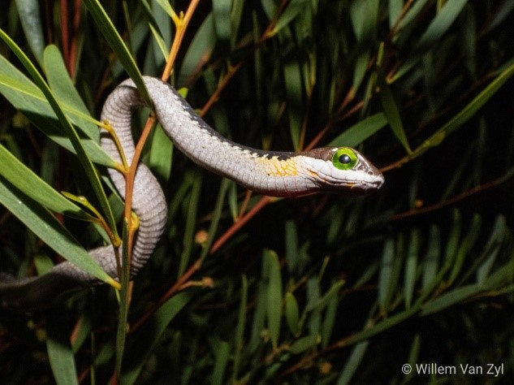
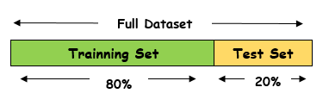
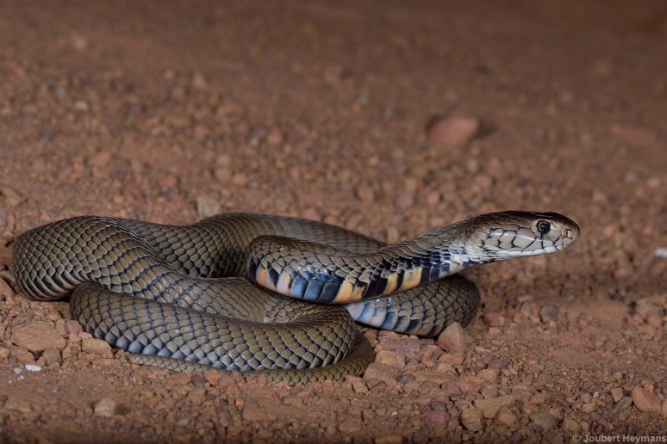
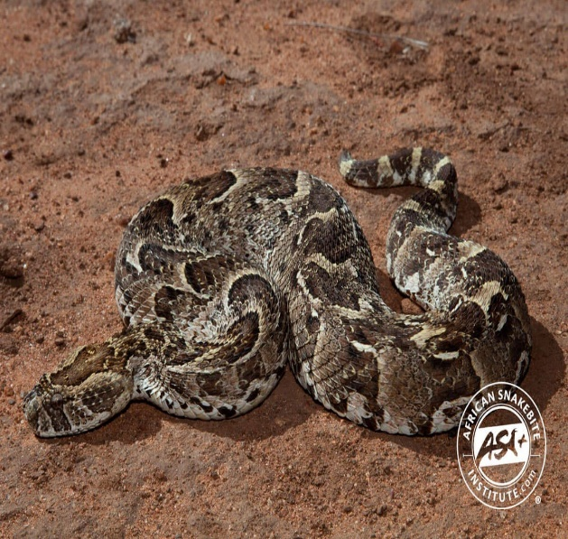
DATASET
No. of classes | Image/class
4 | 140
Dendroaspis polylepis
Dispholidus typus
Bitis arietans
Data augmentation
Naja mossambica
Train | Test | Total
2240 | 112 | 2352

Slide 4
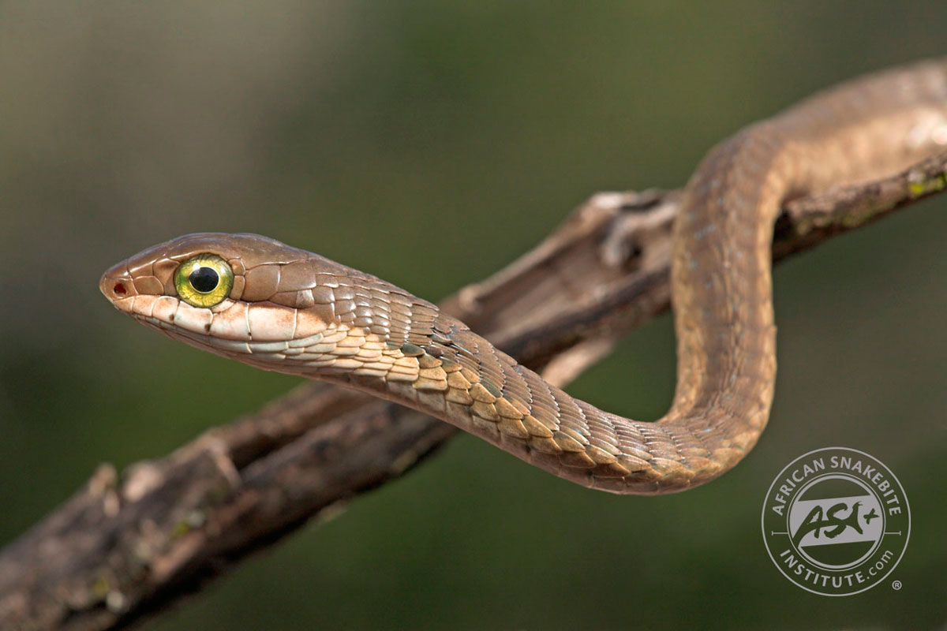
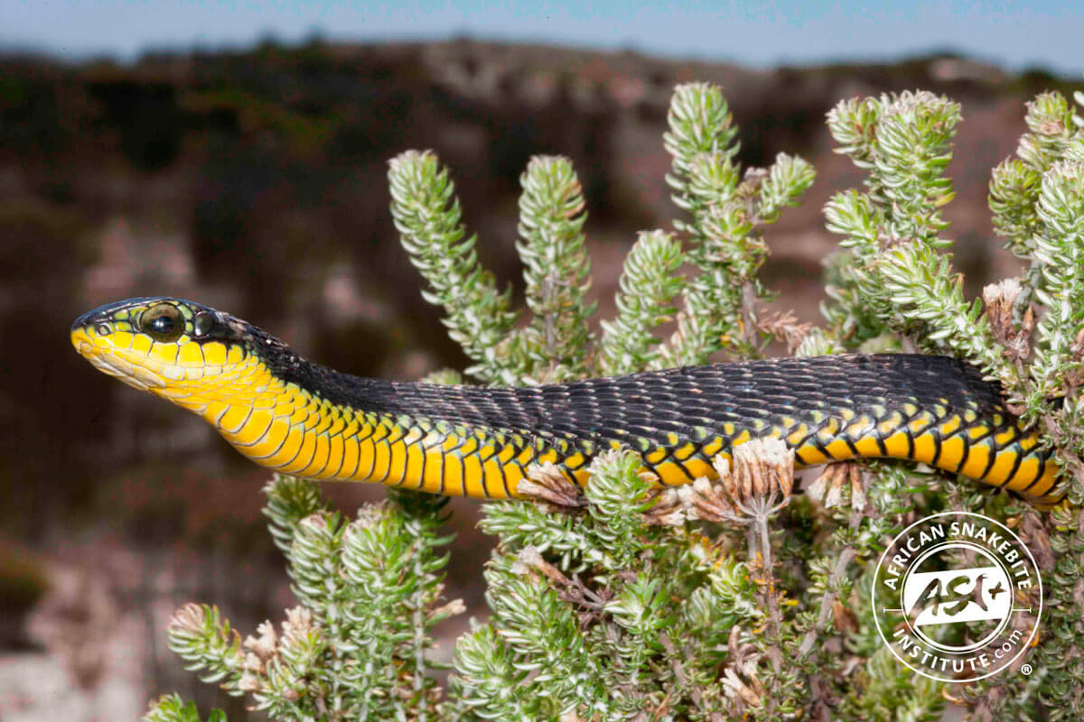
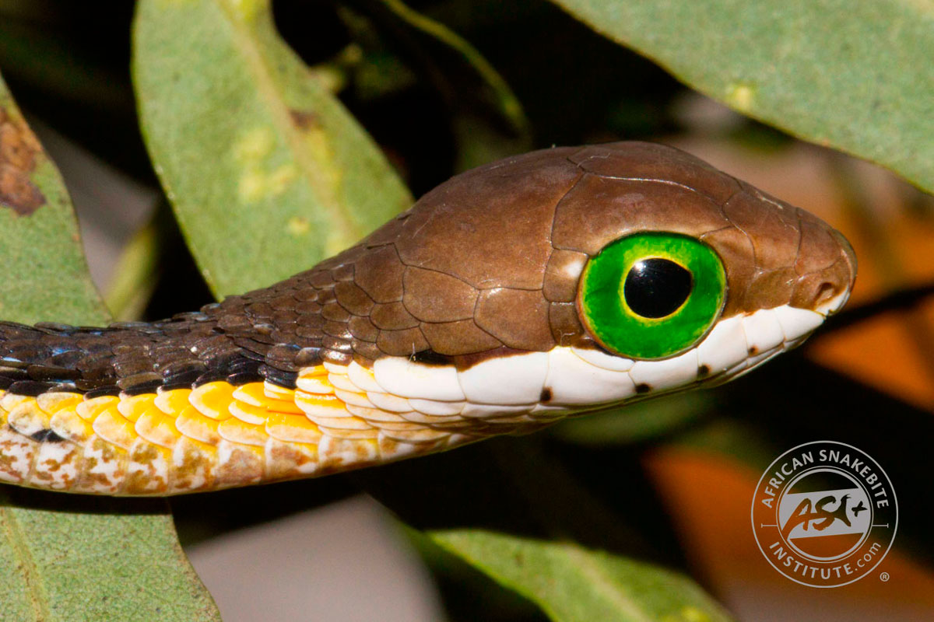
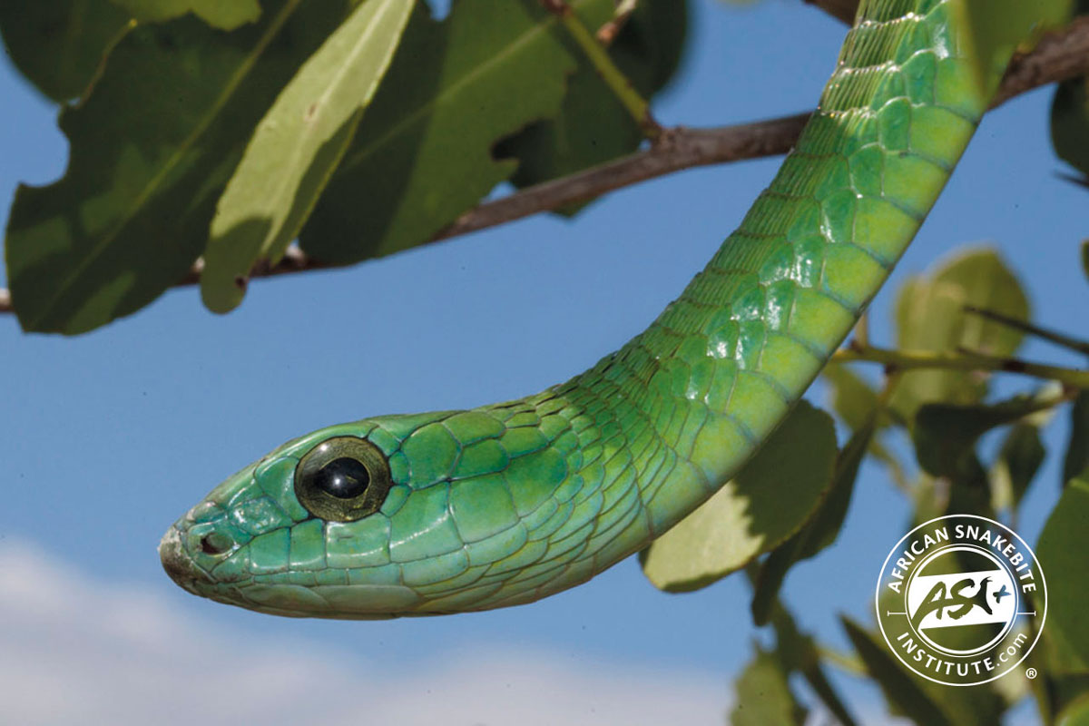
DATASET
Key Caracteristics of dataset:
Snakes in their natural habitat(bushes, trees etc.) i.e the noise.
Snakes have diverse patterns like scales, colour & shape.
Characterstics vary depending on age, sex and location.

Slide 5

MODEL
Xception:
Loss = cross Entropy
Optimizer = Adam learning rate = 1e-5
Epoch = 70
Decision tree:
Max depth = 31
SVM:
Kernel = rbf
Degree = 3
Gamma = 0.00001
MLP:
Random State = 1
Iteration = 300
KNN:
Distance Euclidean

Slide 6

RESULTS
Model | Accuracy | F1 Score | Precision | Recall
Xception | 0.746 | 0.745 | 0.758 | 0.746
KNN (k=2) | 0.554 | 0.562 | 0.633 | 0.554
SVM | 0.741 | 0.739 | 0.746 | 0.741
MLP | 0.589 | 0.594 | 0.620 | 0.589
Decision tree | 0.571 | 0.570 | 0.576 | 0.571

Slide 7
CONCLUSION
Snake Identification is challenging due to factors that can change the snake pattern.
Snakes tend to emrge with their environment which made it diffucult for the models to classify.
SVM & Xception performed better due to a slight advantage over the other models in terms of image classification.
Data Augmentation will play a huge role in trying to improve the performances of the models.

